Slide 1

New York Japanese Restaurants
Brandon O’Grady

Slide 2
“Location, Location, Location”
- Every Business ever

Slide 3
Analyzing NY Japanese Restaurants
1. New York has taken a big hit since the pandemic has started, especially restaurants. Now could be a perfect opportunity for a new restaurant to come in since the rent has lowered and the virus is slowing down.
2. To show the location of the top Japanese restaurants and show what location has the highest rating in New York.
3. To start a restaurant in New York with the perfect location. Location matters and we want to optimize the location the best we can.

Slide 4
Data Acquisition and Cleaning
1. The data source is found from https://cocl.us/new_york_dataset and used with ForSquare to locate all Japanese restaurants.
2. Data was import into Jupyter Notebook and combined with ForSquare to receive all information about the restaurants. The columns were then renamed to our liking and printing into a table.

Slide 5
Exploratory Data Analysis
1. Neighborhoods per Borough
2. Japanese Restaurant per Borough
3. Average Rating of Japanese Restaurant for each Borough and Neighborhood
4. Visual Map

Slide 6
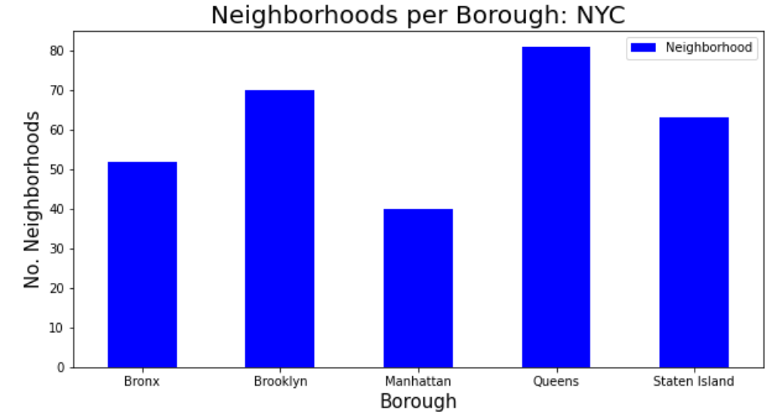
Neighborhoods per Borough

Slide 7
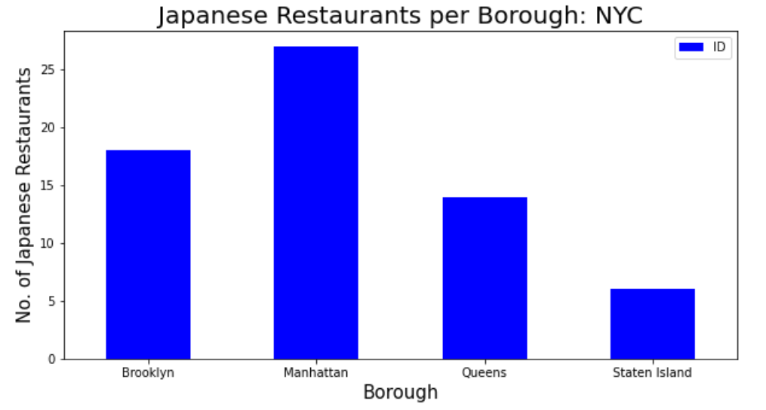
Japanese Restaurant per Borough

Slide 8
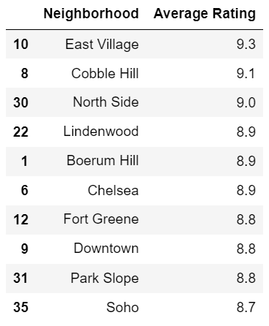
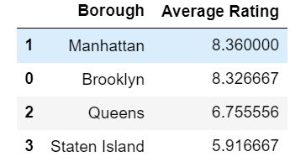
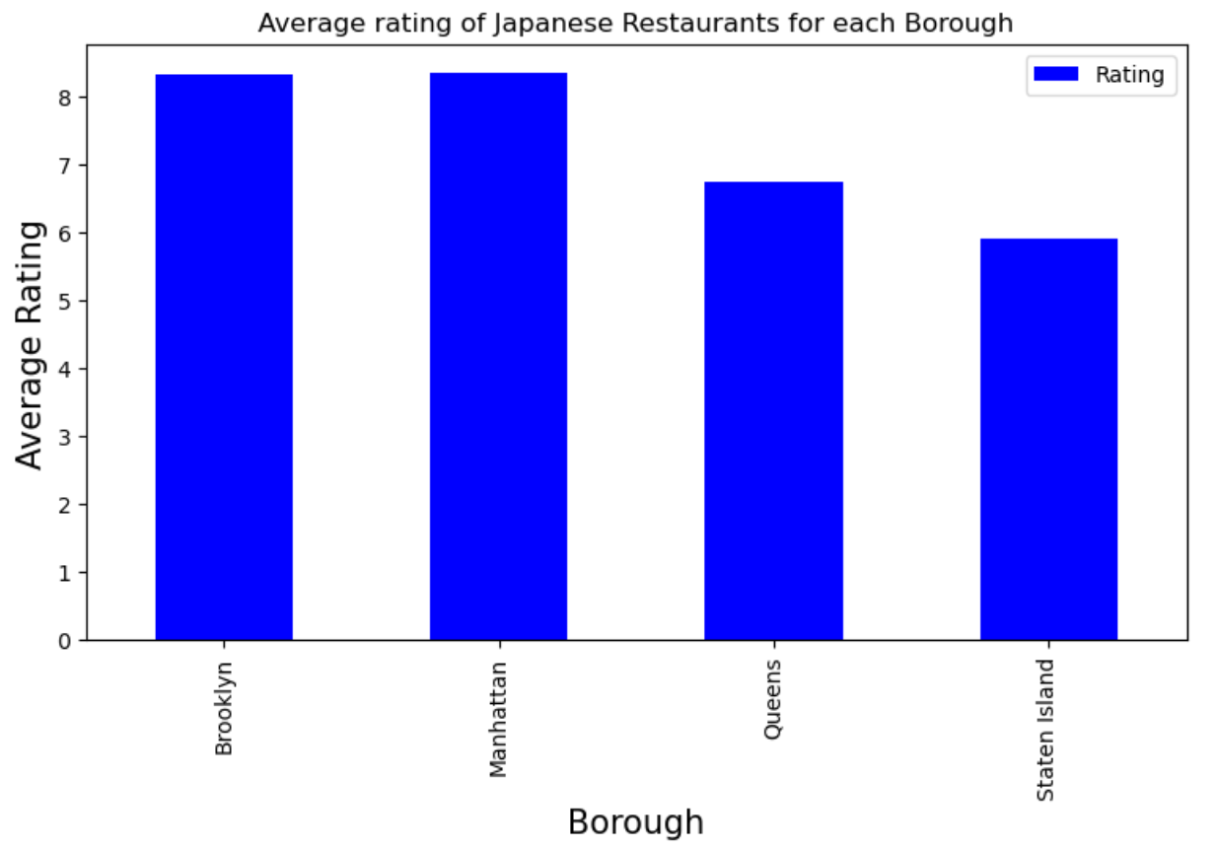
Average Rating of Japanese Restaurant for each Borough and Neighborhood

Slide 9
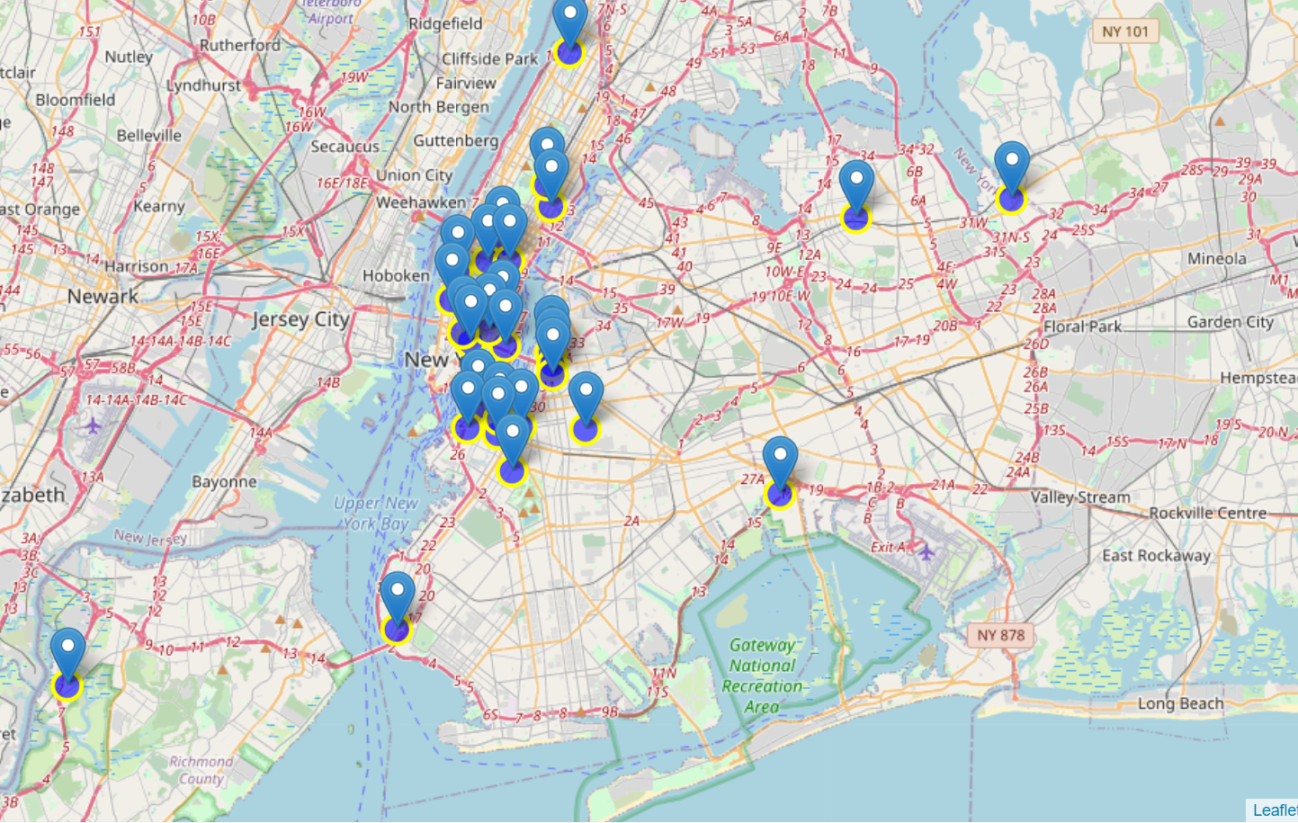
Visual Map

Slide 10
Conclusion
1. Brooklyn and Manhattan has the highest average rating for Borough and East Village, Cobble Hill, and North Side has an average rating of 9 or higher per neighborhood.
2. Placing a restaurant near the best may be hard to compete.
3. A lot of open space not near the popular restuarants.

